Slide 1
CS105
Dr. Briggs (1st five weeks)
Dr. Meehean (2nd five weeks)
Dr. Ribler (3rd five weeks)

Slide 2
3rd Five Weeks
Great Ideas in Computer Science
How do Computer Scientists Think?
What do Computer Scientists Do?
Why is Computer Science Awesome?

Slide 3
What is Computer Science?
Computer science is the study of computers and computer software.
It is really more like an engineering discipline than it is like a science.
Computer science is a very new field of study, yet it already has scores of subfields

Slide 4
What is Computer Science?
Computer science is the study of computers and computer software.
It is really more like an engineering discipline than it is like a science.
Computer science is a very new field of study, yet it already has scores of subfields

Slide 5
A Sampling of Subfields in Computer Science
Artificial Intelligence (AI)
Software Engineering
Human-Computer Interaction (HCI)
Parallel Processing
Computer Graphics
Computer Aided Design (CAD)
Compiler Development/Tools
Robotics

Slide 6
Simulation
Performance Analysis
Operating Systems Design
Speech/Natural Language Recognition
Database Design
Theory of computation
Virtual Reality (VR)
Computer Architecture
Web-based Technologies
and many, many more.

Slide 7
What do these subfields have in common?
Programming is central to almost every one of these subfields.

Slide 8
Good things about Computer Science
You might really enjoy it!
It is a very dynamic field
but the “basics” tend to stay the same
It is an applied “science.”
You should be able to apply virtually everything you learn.
It can provide a very good career
It can support work in virtually every other field

Slide 9
Programming can be a very creative process.
Programmers are writers and engineers.
There are many, many ways to accomplish the same task.
Computer science is very new. There are a lot of opportunities to be innovative.
You can build new products without investing a lot of cash.

Slide 10
What do CS majors do when they graduate?
Most are hired to develop software (program)
Productivity Programs
Operating Systems
WEB Applications (e-commerce)
Computer Graphics
Artificial Intelligence
Medical Software (CT Scan, MRI)
Aerospace Applications
Computation Biology
Research
Embedded Systems
Military Applications
Business Applications
Educational Software
Games
Movies/Entertainment

Slide 11
What do CS majors do when they graduate?
Some work as network and system administrators
Some go to graduate school
Some get research jobs
Some teach
Some start their own companies

Slide 12
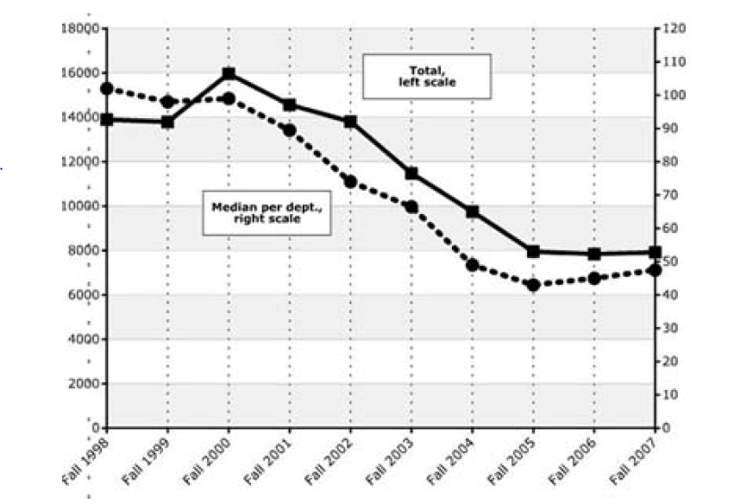
National Trends in Computer Science Enrollment
Enrollment Trends 2000-2005
50% reduction in enrollment in CS courses
70% reduction in major declarations
2007 to 2011 have had significant increases

Slide 13
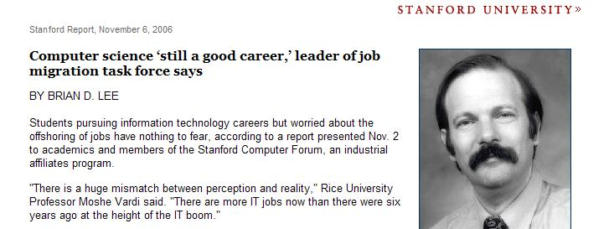
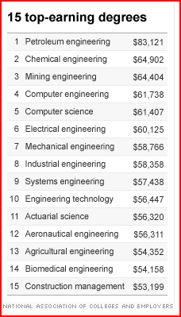
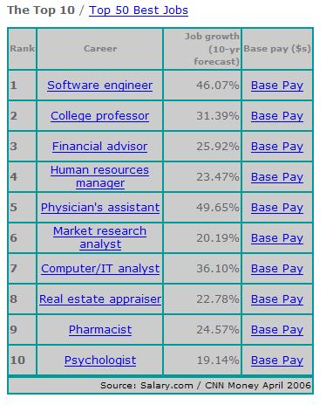
Employment Outlook is Very Positive for Computer Science Graduates

Slide 14
Job Outlook

Slide 15
The Best Jobs in America
http://money.cnn.com/magazines/moneymag/bestjobs/2010/

Slide 16
Learning to program is like learning to play tennis.
At first, you need to master fundamentals.
It will get to be much more fun as you become better at it.
You need to practice. You can’t do all the practicing the night before the match.
It might be frustrating at first, but you will be rewarded if you persevere.
You can’t really judge how much you like it until you get to a certain level of competency.
Anyone can do it if they dedicate enough time to it.

Slide 17
What do computers do?
They do very, very, simple things
basic arithmetic on values in memory
Input/Output
Comparison and Conditional Execution
if-statements
They do it very, very, fast and very, very reliably.
Programmers build systems to do complicated things using these simple basic capabilities.

Slide 18
Think of a recipe.
We can use instructions that provide different levels of detail.
High Level
Make an apple pie
Lower Level
Slice 4 apples into one inch squares...
Even Lower Level
Pick up a knife, place the knife on the apple, apply pressure, …

Slide 19
Algorithms for Selecting a Mate
Randy Ribler
Computer Science
Lynchburg College

Slide 20
What is an Algorithm?
Algorithm
A method for solving a problem that is suitable for implementation on a computer.
What algorithms can we apply to the problem of selecting a mate?
Gale-Shapley Algorithm for Solving the Stable Marriage Problem
Dynamic Programming To Solve the Optimal Stopping Problem (known distribution)
Analysis of Permutations to Solve the Stopping Problem (unknown distribution)

Slide 21
Can Software Help a Sit-Com?

Slide 22
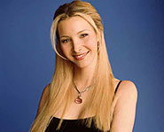
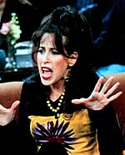
Rachel
Phoebe
Monica
Emily
Kathy
Janice
Mona
Julie

Slide 23
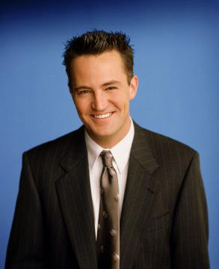
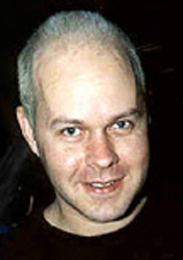
Joey
Chandler
Ross
Gunter
Joshua
Pete
Tag
Richard

Slide 24
Creation of Rankings
Each friend creates an ordered list containing all the other friends of the opposite sex such that the evaluation function for the i^{th} member of the list has a higher value than the (i+1)^{st} member of the list.

Slide 25
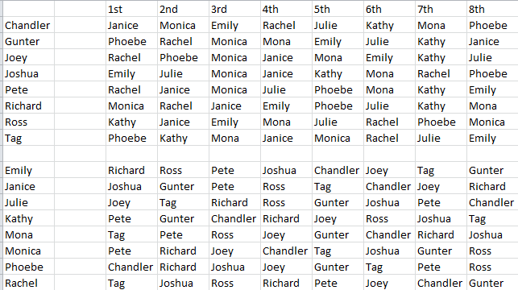
Complete Rankings

Slide 26
The Stable Marriage Problem
A particular matching is unstable if there are two parties who are not matched with each other who prefer each other to their current match. These two parties comprise a blocking pair.
A matching is stable if it contains no blocking pairs.

Slide 27
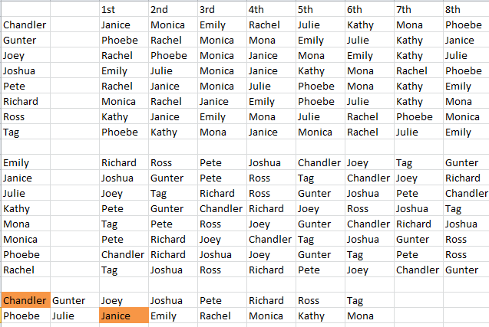
An Unstable matching

Slide 28
Gale-Shapley Algorithm
All participants list all members of the opposite sex in order of preference.
One of the two sets (men or women) will do all the proposing.

Slide 29
Gale-Shapley From the Proposer’s Point of View
Propose to each person on your list (starting with your 1st choice) until you become engaged.
If your engagement is broken, continue proposing (from where you were in your list at the time of your engagement) until you become engaged again.

Slide 30
Gale-Shapley from the Proposee’s Point of View
If you are unengaged and you get a proposal – accept it, no matter who it is from.
If you are engaged and someone that you like better than your fiancée proposes, break your current engagement and accept the new proposal.

Slide 31
Theorem 1 for Gale-Shapley
For any given instance of the stable marriage problem, the Gale-Shapley algorithm terminates, and, on termination, the engaged pairs constitute a stable matching.

Slide 32
Proof of Theorem 1
No man can be rejected by all women
Equal numbers of men and women
Any unengaged woman will accept any proposal
Each man proposes to each woman no more than once
The matching is stable
No men are leaving their match
All the women that each man prefers to his fiancée have rejected his proposal in favor of a preferred partner.

Slide 33
Men Proposing
Janice accepts proposal from Chandler
Phoebe accepts proposal from Gunter
Rachel accepts proposal from Joey
Emily accepts proposal from Joshua
Rachel accepts proposal from Pete (rejects Joey)
Phoebe accepts proposal from Joey (rejects Gunter)
Monica accepts proposal from Gunter
Monica accepts proposal from Richard (rejects Gunter)
Mona accepts proposal from Gunter
Kathy accepts proposal from Ross
Mona accepts proposal from Tag (rejects Gunter)
Julie accepts proposal from Gunter
Matching:
(Chandler (1), Janice (6))
(Gunter (6), Julie (5))
(Joey (2), Phoebe (4))
(Joshua (1), Emily (4))
(Pete (1), Rachel (5))
(Richard (1), Monica (2))
(Ross (1), Kathy (6))
(Tag (3), Mona (1))

Slide 34
Men Proposing (reverse order)
Phoebe accepts proposal from Tag
Kathy accepts proposal from Ross
Monica accepts proposal from Richard
Rachel accepts proposal from Pete
Emily accepts proposal from Joshua
Phoebe accepts proposal from Joey (rejects Tag)
Mona accepts proposal from Tag
Julie accepts proposal from Gunter
Janice accepts proposal from Chandler
Matching:
(Tag (3), Mona (1) )
(Ross (1), Kathy (6))
(Richard (1), Monica (2))
(Pete (1), Rachel (5))
(Joshua (1), Emily (4))
(Joey (2), Phoebe (4))
(Gunter (6), Julie (5))
(Chandler (1), Janice (6))

Slide 35
Women Proposing to Men
Richard accepts proposal from Emily
Joshua accepts proposal from Janice
Joey accepts proposal from Julie
Pete accepts proposal from Kathy
Tag accepts proposal from Mona
Pete accepts proposal from Monica (rejects Kathy)
Gunter accepts proposal from Kathy
Chandler accepts proposal from Phoebe
Ross accepts proposal from Rachel
Matching:
(Emily (1), Richard (4) )
(Janice (1) , Joshua (4) )
(Julie (1), Joey (8))
(Kathy (2) , Gunter (7))
(Mona (1) , Tag (3))
(Monica (1) , Pete (3))
(Phoebe (1) , Chandler (8))
(Rachel (3) , Ross (6))

Slide 36
Amazing Theorems of Gale-Shapley
All possible executions of the algorithm (varying the order of proposals) will yield the same matching.
In the woman-proposing stable matching, every woman has the best partner that she will have in any stable matching!
In the woman-proposing stable matching, every man will have the worst partner that he will have in any stable matching!

Slide 37
Two Stable Matchings

Slide 38
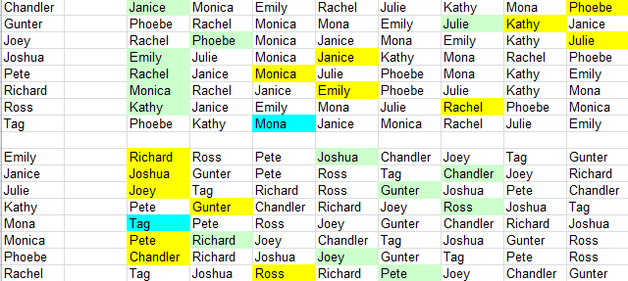
Partners in Best and Worst Stable Matchings

Slide 39
So Gale-Shapley is stable, but is it fair?
Theorem 3 -
In the woman-proposing stable matching, every woman has the best partner that she will have in any stable matching!
In the woman-proposing stable matching, every man will have the worst partner that he will have in any stable matching!

Slide 40
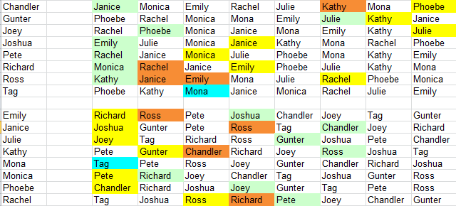
Other Stable Matchings
There are 6 other stable matchings

Slide 41
Considerations Other Than Stability
Test all 8! = 40320 matchings
Best average ranking (unstable)
Most with top 2 choices (unstable)
Lowest single ranking (unstable)

Slide 42
How do we know there are 8! Matchings?
Imagine that we list the names of the women in one row.
How many different ways can we list the 8 men?
A | B | C | D | E | F | G | H

Slide 43
Table of Factorials
1 | 1 |  | 11 | 39916800 |  | 21 | 5.11E+19 |  | 31 | 8.22E+33
2 | 2 |  | 12 | 4.79E+08 |  | 22 | 1.12E+21 |  | 32 | 2.63E+35
3 | 6 |  | 13 | 6.23E+09 |  | 23 | 2.59E+22 |  | 33 | 8.68E+36
4 | 24 |  | 14 | 8.72E+10 |  | 24 | 6.2E+23 |  | 34 | 2.95E+38
5 | 120 |  | 15 | 1.31E+12 |  | 25 | 1.55E+25 |  | 35 | 1.03E+40
6 | 720 |  | 16 | 2.09E+13 |  | 26 | 4.03E+26 |  | 36 | 3.72E+41
7 | 5040 |  | 17 | 3.56E+14 |  | 27 | 1.09E+28 |  | 37 | 1.38E+43
8 | 40320 |  | 18 | 6.4E+15 |  | 28 | 3.05E+29 |  | 38 | 5.23E+44
9 | 362880 |  | 19 | 1.22E+17 |  | 29 | 8.84E+30 |  | 39 | 2.04E+46
10 | 3628800 |  | 20 | 2.43E+18 |  | 30 | 2.65E+32 |  | 40 | 8.16E+47

Slide 44
Friends – Proposed Episode
Joey finds an explanation of the Gale-Shapley algorithm and explains it to the other men. They decide to propose the use of the man-proposing version to solve all their problems.
The women agree to use the algorithm, but later, Monica and Phoebe discover that the algorithm will yield the worst possible stable matching for all of the women.
Is there a way that women can lie about their preferences to obtain a better result?

Slide 45
Suppose that there were only 4 Women in Ross’s Future
For Large Values of N, the optimal value is 1/e, which is approximately 37%. It will yield the optimal results approximately 37% of the time.

Slide 48
Stopping Problem with a Known Distribution
Phoebe has been single for a long time and has noticed that the evaluation scores for the men that she dates are uniformly distributed between 0 and 1000. Her fortune teller says that she will meet 10 more compatible men in her life. Her current boyfriend has an evaluation of 750. What should she do?

Slide 49
Dynamic Programming to the Rescue!
Dynamic programming is a frequently utilized technique that solves a problem by working back from a final state.
What is the expected value of the evaluation function for Phoebe’s very last potential suitor?
1000/2 = 500

Slide 50
Phoebe’s Dynamic Programming Solution
Phoebe knows that the expected value of the evaluation for her last suitor is 500.
If her second to last suitor has an evaluation of less than 500, she will reject him, because she can expect a 500 (on average) from her last suitor.
1 | 2 | 3 | 4 | 5 | 6 | 7 | 8 | 9 | 10
 |  |  |  |  |  |  |  |  | 500
If (9th suitor Evaluation < 500) reject, otherwise accept

Slide 51
What about the 8th Suitor?
Any accepted 9th suitor has a value between 500 and 1000. (expected value = 750).
The expected value of the 10th suitor is 500
So she will reject the 8th suitor if the evaluation function yields less than (500+750)/2 = 625
1 | 2 | 3 | 4 | 5 | 6 | 7 | 8 | 9 | 10
 |  |  |  |  |  |  |  | 625 | 500
If (8th suitor Evaluation < 625) reject, otherwise accept

Slide 52
What about the 7th Suitor?
Any accepted 8t^{h} suitor has a value between 625 and 1000. (expected value = (625+1000)/2 = 812).
The expected value of the 9th suitor is 625
So she will reject the 8th suitor if the evaluation function yields less than
((375/1000)*812 + (625/1000)*625)
1 | 2 | 3 | 4 | 5 | 6 | 7 | 8 | 9 | 10
 |  |  |  |  |  |  | 695 | 625 | 500
If (7th suitor Evaluation < 695) reject, otherwise accept

Slide 53
What about the rest?
Phoebe uses the same technique to fill in the rest of the table
She dumps her current boyfriend, who, at 750, is worse than the value that she can expect if she rejects him.
1 | 2 | 3 | 4 | 5 | 6 | 7 | 8 | 9 | 10
861 | 850 | 836 | 820 | 800 | 775 | 742 | 695 | 625 | 500
If (1st suitor Evaluation < 850) reject, otherwise accept

Slide 54
Problems with all these approaches?
People can’t reliably rank each other.
Ranks can change quickly
Which group do we optimize for?
People don’t really know their own evaluation functions
It’s not very romantic

Slide 55
Fortunately there are plenty of places in which these algorithms are useful
Stable Marriage
Matching residents to hospitals
Matching law students to judges
Dynamic Programming
Many optimizations problems
Many programming competition problems
Optimal stopping (37% rule)
Finding a good restaurant

Slide 56
Acknowledgements
David K. Smith, Mathematical Statistics and Operational Research Department, University of Exeter.
Dan Gusfield and Robert W. Irving, The Stable Marriage Problem, Structure and Algorithms

Slide 57
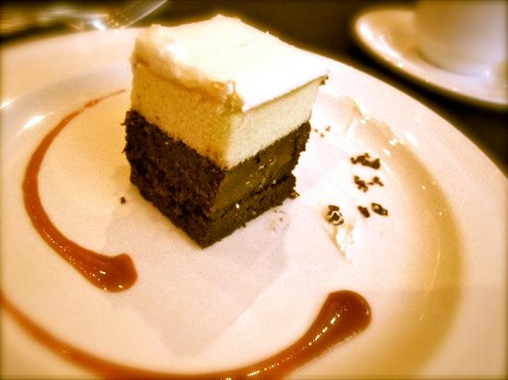
Fair Division

Slide 58
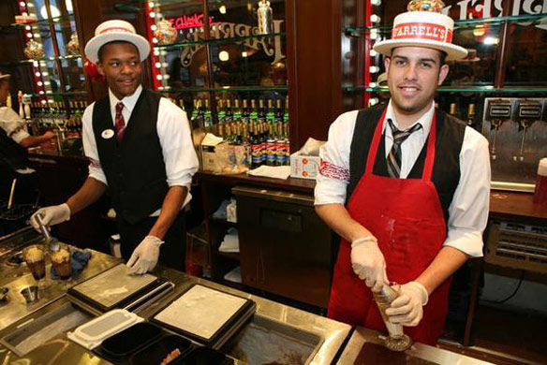
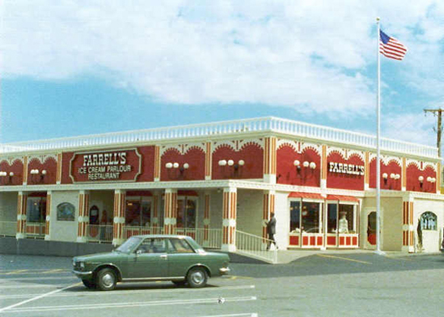
Restaurant Shift Workers

Slide 59
Each Week Different Schedules
 | Morning Shifts Servers
Monday | Tuesday | Wednesday | Thursday | Friday | Saturday | Sunday
Julie | ..
Michael | ..
Lori | ..
Ann | ..
Mary | ..
: | ..
. | ..

Slide 60
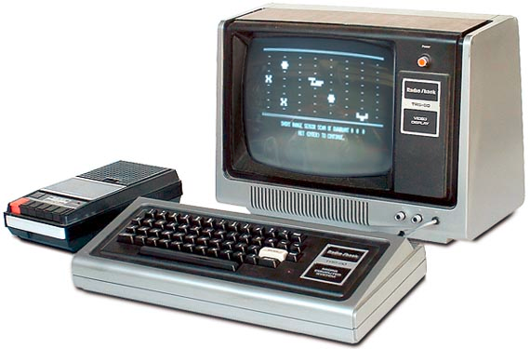
How can we automatically generate fair schedules?
Input
Weekly shift requirements
Worker desire to work each shift
Output – Fair Schedule

Slide 61
Generating Weekly Schedules
Different requirements each week
Historical data used to predict number of customers
Most workers were students, and their schedules often changed week to week
It wouldn’t be fair to have the same schedule every week
Different shifts made different salaries

Slide 62
Fairness
Poorly defined – but perhaps we know it when we see it.
Multifaceted – it is rare that we can optimize for a single variable
It should not be confused with stability

Slide 63
Criteria for Fairness
Cooperating versus Spiteful
Cooperating
Participants want to maximize average happiness
Spiteful
Participants want to maximize their own happiness, and minimize the happiness of other participants.

Slide 64
Recurring versus Nonrecurring
Matchings are produced more than once (e.g., scheduling shift workers)
Compensation for a bad matching one week can be provided with a good matching another week
There is just one matching (e.g., stable marriage)
There is no opportunity for future compensation

Slide 65
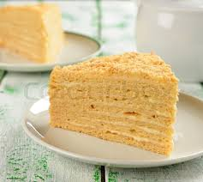
You cut I’ll pick algorithm
One person cuts the cake into two portions she considers equal
The other person selects their preferred portion

Slide 66
Envy-free Division
A division is envy-free if no player prefers someone else’s portion to their own.
The “You cut I’ll pick” algorithm is envy-free
The cutter believes the portions are equal, so has no preference
The selector takes the portion they prefer. If they preferred the other portion they would have taken it.

Slide 67
Is the algorithm fair?
Homogenous Cake
Fair if the cutter can produce a flawless cut
Without flawless cutting, the second player will have an advantage
Non-homogenous Cake
If the value of different parts of the cake are subjective
The second player is guaranteed at least 50% of the subjective value
The first player is guaranteed only 50%

Slide 68
Cake Cutting Algorithms
These algorithms have been extended to n players
They generate envy-free results
They do not take advantage of subjective value

Slide 69
Super-fair divisions
All participants receive the expected value of their share and often more
Exploits differences in the values different players place on components of the partitioned resource

Slide 70
Fair Division of Multiple Items
Divide a set of items that are in dispute
Divorce settlements
Estate settlements

Slide 71
Adjusted Winner
Each player assigns a number of points to each item in dispute. The total points assigned should be 100.
The player with the larger point assignment wins each item in dispute.
Ties are awarded to the player with fewer points

Slide 72
Adjusted Winner (continued)
Transfer items initially awarded to the player with more points to the player with fewer points until the player with fewer points catches up.
The item transferred is the item for which winnersBid/losersBid is smallest.
When transferring an item would cause the player with fewer points to surpass the player with more points, split the item.

Slide 73
Properties of AW
Envy-free
Equitable – Both players believe they have received the same amount of their valuation
Efficient – There is no allocation that is strictly better for one player and as good for the other.

Slide 74
AW Example (from http://www.nyu.edu/projects/adjustedwinner/)
Item | Carol | Bob
Retirement Account | 50 | 40
Home | 20 | 30
Summer Cottage | 15 | 10
Investments | 10 | 10
Other | 5 | 10
Total | 100 | 100
Carol: 50+15 = 65
Bob: 30 + 10 = 40

Slide 75
Bob gets the ties (from http://www.nyu.edu/projects/adjustedwinner/)
Item | Carol | Bob
Retirement Account | 50 | 40
Home | 20 | 30
Summer Cottage | 15 | 10
Investments | 10 | 10
Other | 5 | 10
Total | 100 | 100
Carol: 50+15 = 65
Bob: 30 + 10 + 10= 50

Slide 76
Bob can’t have all the RA (from http://www.nyu.edu/projects/adjustedwinner/)
Item | Carol | Bob
Retirement Account | 50 | 40 | 1.25
Home | 20 | 30
Summer Cottage | 15 | 10 | 1.5
Investments | 10 | 10
Other | 5 | 10
Total | 100 | 100
Carol: 15 = 15
Bob: 30 + 10 + 10 + 40 = 90

Slide 77
Splitting an Item - Terms
H_{t} = The value of the items awarded to the person with the higher total (not including the value of the item that will be split)
L_{t} = The value of the items awarded to the person with the lower total (not including the value of the item that will be split)
H_{b} = Bid of the person with the higher total on the item that will be split
L_{b} = Bid of the person with the lower total on the item that will be split

Slide 78
The Account is Split to make the amount equal
We want the final awards to be of identical value, so
H_{t} + H_{b}*p = L_{t} +L_{b}*(1-p)
In our example we get:
50 + 40p = 15 + 50(1-p)
P = 1/6
Carol: 15 + (50* 5/6) = 56 2/3
Bob: 30 + 10 + 10 + 40*1/6 = 56 2/3

Slide 79
Calculation of P
Generally, we can calculate p as:
P = (L_{t}+L_{b}-H_{t})/(H_{b}+L_{b})

Slide 80
Pirates!*
10 Pirates need to divide 100 pieces of gold
Individual pieces of gold cannot be split
The pirates are ranked from strongest P9 to weakest P0. No two pirates have the same strength.
*Problem from Stewart, I. (1999) A Puzzle for Pirates. Scientific American,
May 1999 as described in the book: “How to Solve It: Modern Heuristics”,
By Zbigniew Michalewicz and David B. Fogel

Slide 81
Pirate Justice
The pirates decide to divide the treasure using the following algorithm
While 50% or more of the pirates have not agreed on a proposal
Allow the strongest remaining pirate to propose how the treasure might be divided
If the proposal is rejected, throw the proposing pirate overboard

Slide 82
What should P9 Propose?
P9 is at risk of getting thrown overboard. He needs to get at least a 50% of the vote for his proposal to pass.

Slide 83
P9 needs to consider the other pirates’ alternatives
What will they get if they reject his proposal?
They will get an offer from P8
What if they reject P8’s proposal?
They will get an offer from P7
What if they reject P7’s proposal?
They will get an offer from P6
What if they reject p6’s proposal?
They will get an offer from p5
What if they reject P5’s proposal
They will get an offer from p4
What if they reject P4’s propsal?
…….

Slide 84
Let’s see what happens if all proposals are rejected
P0 will get 100 pieces of gold
But this can never happen
P1 will first propose that P1 gets 100 pieces of gold. His own vote constitutes 50% of the vote and his proposal will succeed.

Slide 85
P2
P2 knows that P1 will get everything if P2’s proposal fails. P0 knows this two. P2 just needs to convince P0 that his plan is better than the nothing he receives with P1’s plan.
P2 will propose that P2 receive 99 pieces of gold and P0 gets one piece.
This proposal will succeed.

Slide 86
P3
Under P2’s proposal, P1 gets nothing. Now P1 is easy to bribe.
P3 proposes the following
P3 gets 99 pieces of gold
P2 gets nothing
P1 gets
P0 gets nothing
P3’s proposal will pass

Slide 87
P4
 | P9 | P8 | P7 | P6 | P5 | P4 | P3 | P2 | P1
P9 | 96
P8 | 0 | 96
P7 | 1 | 0 | 97
P6 | 0 | 1 | 0 | 97
P5 | 1 | 0 | 1 | 0 | 98
P4 | 0 | 1 | 0 | 1 | 0 | 98
P3 | 1 | 0 | 1 | 0 | 1 | 0 | 99
P2 | 0 | 1 | 0 | 1 | 0 | 1 | 0 | 99
P1 | 1 | 0 | 1 | 0 | 1 | 0 | 1 | 0 | 100
P0 | 0 | 1 | 0 | 1 | 0 | 1 | 0 | 1 | 0
Even numbered pirates payoff even numbered pirates
Odd numbered pirates payoff odd numbered pirates

Slide 88
More Pirates
What if there are more pirates? For
0<n<200
Pn pays off n/2 pirates with one piece of gold each, and takes (100-n/2) for himself.
Example:
P4 pays off 2 pirates and keeps 98
P50 pays off 25 pirates and keeps 75
P200 pays of 99 pirates and keeps 1
What about P201?

Slide 89
P201
P201 needs 101 votes. He has to payoff 100 of his fellow pirates. That requires all the gold. P201 gets nothing, but escapes with his life.
P202 can survive with the same strategy.
What about P203?

Slide 90
P203 is in Trouble
Pirate 203 needs 102 votes. He can payoff 100 pirates and can vote for his own proposal, but that still comes to just 101 votes.
Pirate 203 is going for a swim.
Given the chance, P203 will give P204 his full support!

Slide 91
P204
P204 needs 102 votes
He has P203’s vote
He has his own vote
He can buy 100 votes
That adds up to 102 votes
P204 can save himself
He needed 1 ally (2¹-1)

Slide 92
P205
P205 needs 103 votes
He has no allies
He will swim
P206 needs 103 has 102
P207 needs 104 has 103

Slide 93
P208
P208 needs 104 votes
P205, P206, P207 will support him to so that they will not be thrown overboard
P208 has his own vote
P208 has 3 allies (P205, P206, P207)
P208 can bribe 100 other pirates
P208 survives with 104 votes
He needed 3 allies (2²-1)

Slide 94
P209 to P215
P209 needs 105 votes, can get 101
P210 needs 105 votes, can get 102
P211 needs 106 votes, can get 103
P212 needs 106 votes, can get 104
P213 needs 107 votes, can get 105
P214 needs 107 votes, can get 106
P215 needs 108 votes, can get 107

Slide 95
P216
P216 needs 108 votes
P209, P210, P211, P212, P213, P214, and P215 are his 7 allies
Votes of 7 allies plus
His own vote plus
100 bribed pirates
P216 has 108 votes and can save himself
He needed 7 allies (2³-1)

Slide 96
The following Pirates can save themselves
Pirate | Allies
P204 | 1 | 2¹-1
P208 | 3 | 2²-1
P216 | 7 | 2³-1
P232 | 15 | 2⁴-1
P264 | 31 | 2⁵-1
P328 | 63 | 2⁶-1
P456 | 127 | 2⁷-1
P712 | 255 | 2⁸-1
P1224 | 511 | 2⁹-1
P2248 | 1023 | 2¹⁰-1
Generally, pirate 202+ 2^{n} (where n>=1) will be able to save himself
with the help of 2^{n}-1 allies.

Slide 97
Distance Vector Routing

Slide 98
Shortest Path Routing (a nonadaptive routing algorithm)
Given a network topology and a set of weights describing the cost to send data across each link in the network
Find the shortest path from a specified source to all other destinations in the network.
Shortest path algorithm first developed by E. W. Dijkstra

Slide 99
Shortest Path Routing
Mark the source node as permanent.
Designate the source node as the working node.
Set the tentative distance to all other nodes to infinity.
While some nodes are not marked permanent
Compute the tentative distance from the source to all nodes adjacent to the working node. If this is shorter than the current tentative distance replace the tentative distance of the destination and record the label of the working node there.
Examine ALL tentatively labeled nodes in the graph. Select the node with the smallest value and make it the new working node. Designate the node permanent.

Slide 100
Example of Shortest Path Routing

Slide 101
Why the Shortest Path Algorithm Works
B
E
A
Z
Perhaps A*ZE is a better path to E than ABE
nodes are made permanent when paths to them are the shortest paths in the graph
All subsequent paths found to permanent nodes will be at least as long as previously found paths
Two cases
1.) If Z is permanent, then we have already checked A*ZE
2.) If Z is tentatively labeled, paths to Z must be longer than paths to E, otherwise Z would have been made permanent

